Slide 1


Slide 2


HO CHI MINH CITY UNIVERSITY OF TECHNOLOGY AND EDUCATION
FACULTY OF INTERNATIONAL EDUCATION
GRADUATION PROJECT
Major: COMPUTER ENGINEERING TECHNOLOGY
FACIAL LANDMARK DETECTION
ON MULTIPLE PLATFORMS USING QUANTIZED MOBILENETV2 FOR EDGE AI APPLICATIONS
MEMBERS: Do Manh Dung 21119301
Dang Trung Nghia 21119313
Advisor: PhD. Pham Van Khoa

Slide 3


TABLE OF CONTENTS
01
02
Introduction
Technical solutions
03
04
Results
Conclusion
05
Future direction
GRADUATION PROJECT 2025
COMPUTER ENGINEERING TECHNOLOGY

Slide 4
01
INTRODUCTION
GRADUATION PROJECT 2025
COMPUTER ENGINEERING TECHNOLOGY

Slide 5

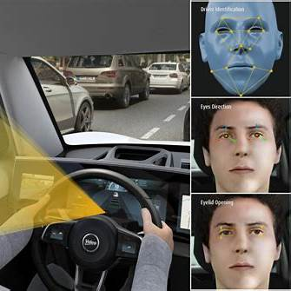

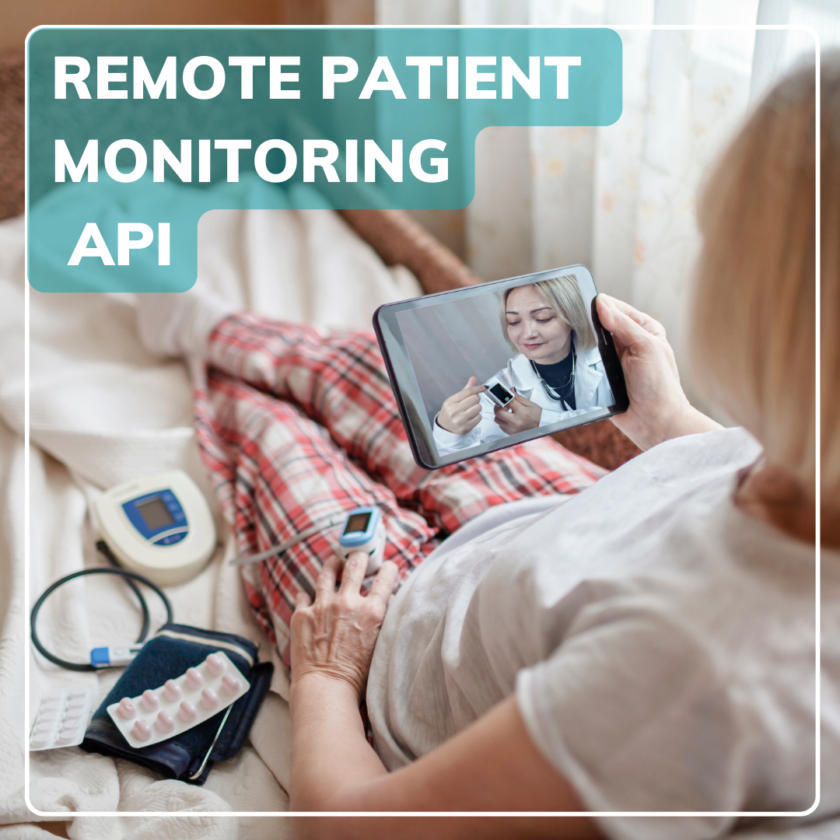
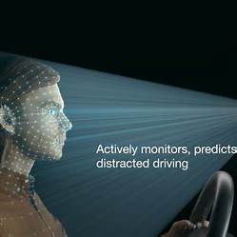
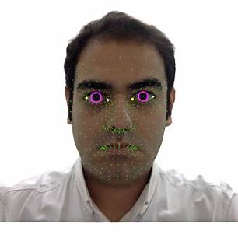
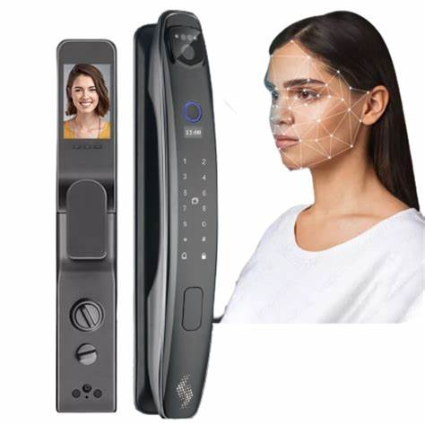
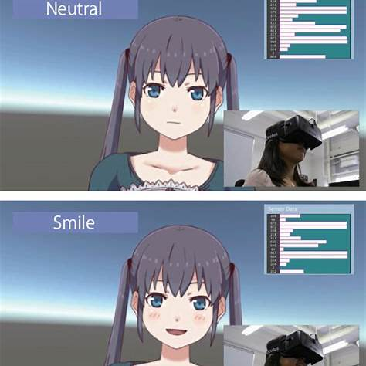
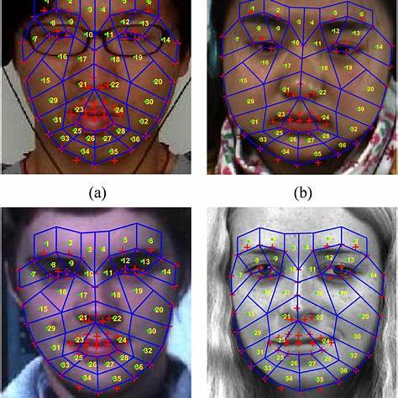
PROBLEM STATEMENT
Driver Monitoring System
Mask Detection
Telemedicine
ADAS Head-Pose
Adjustment
Gaze Tracking
Face Unlock Biometric
Security
VR/AR Expression
Mapping
Expression Detection
GRADUATION PROJECT 2025
COMPUTER ENGINEERING TECHNOLOGY

Slide 6



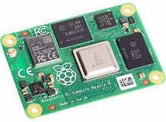

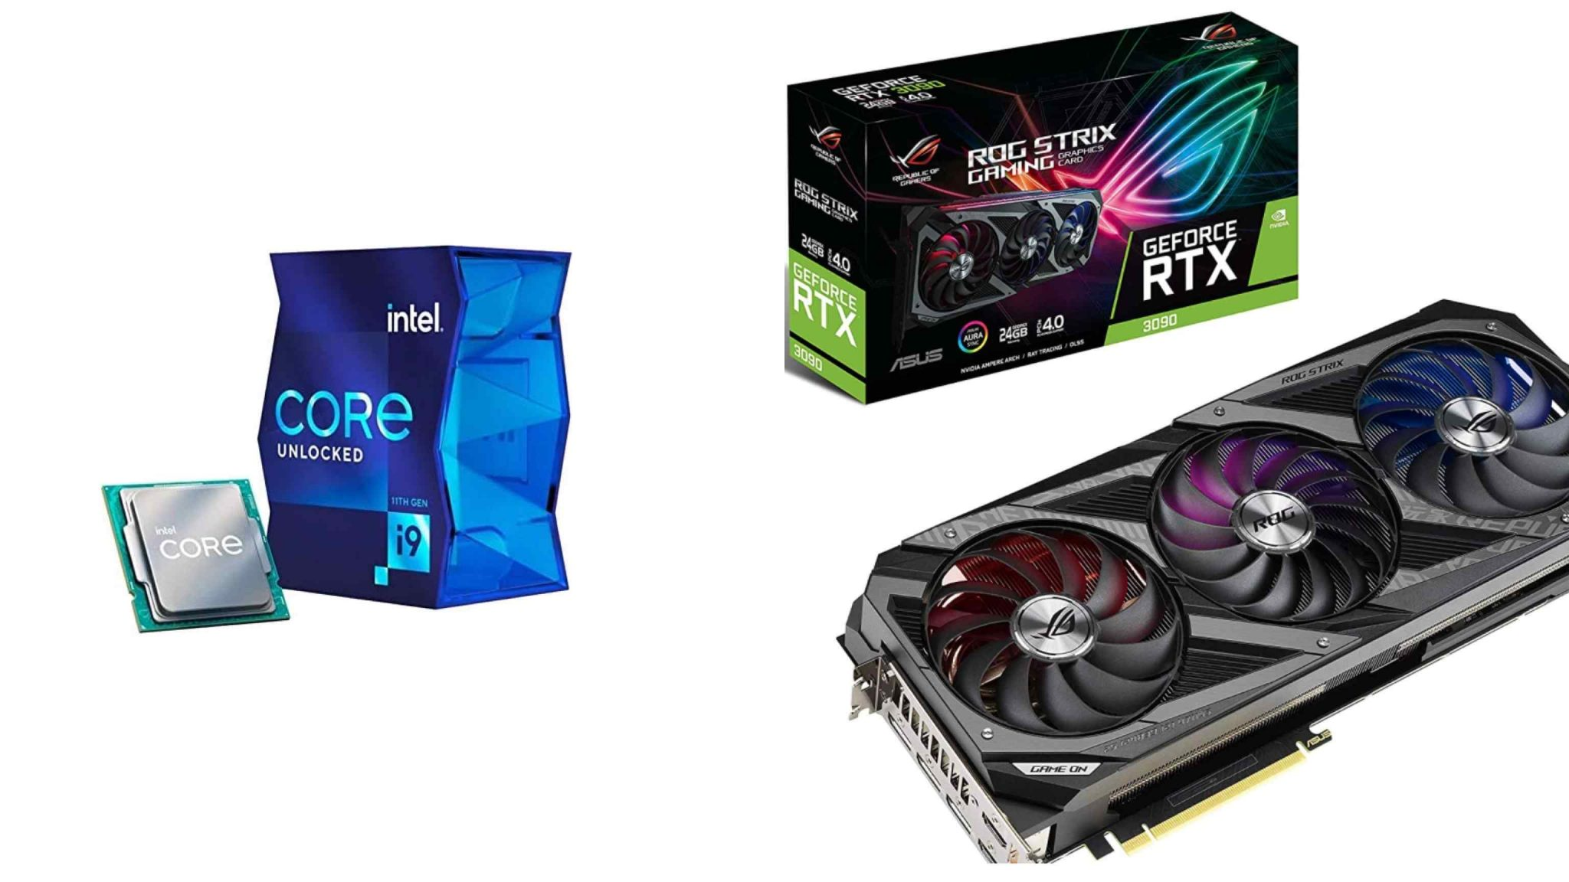
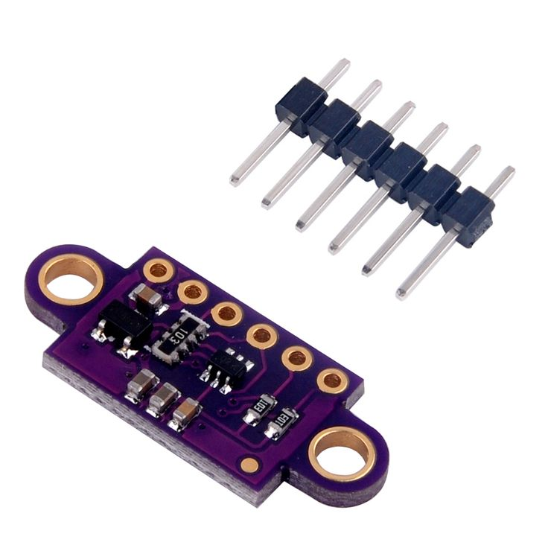


TECHNICAL PROBLEM
Traditional Solutions
High Cost
High Latency
SBCs
Cloud Server
High Energy Consumption
Sensor
GPU/CPU
Inefficient Resource
Limited Scalability
GRADUATION PROJECT 2025
COMPUTER ENGINEERING TECHNOLOGY

Slide 7

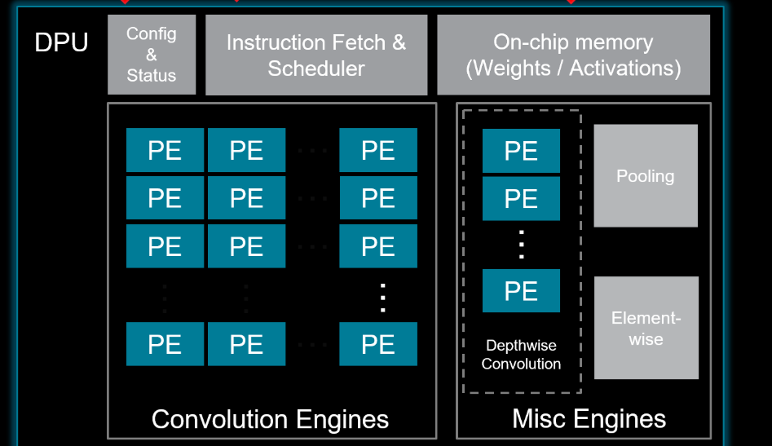
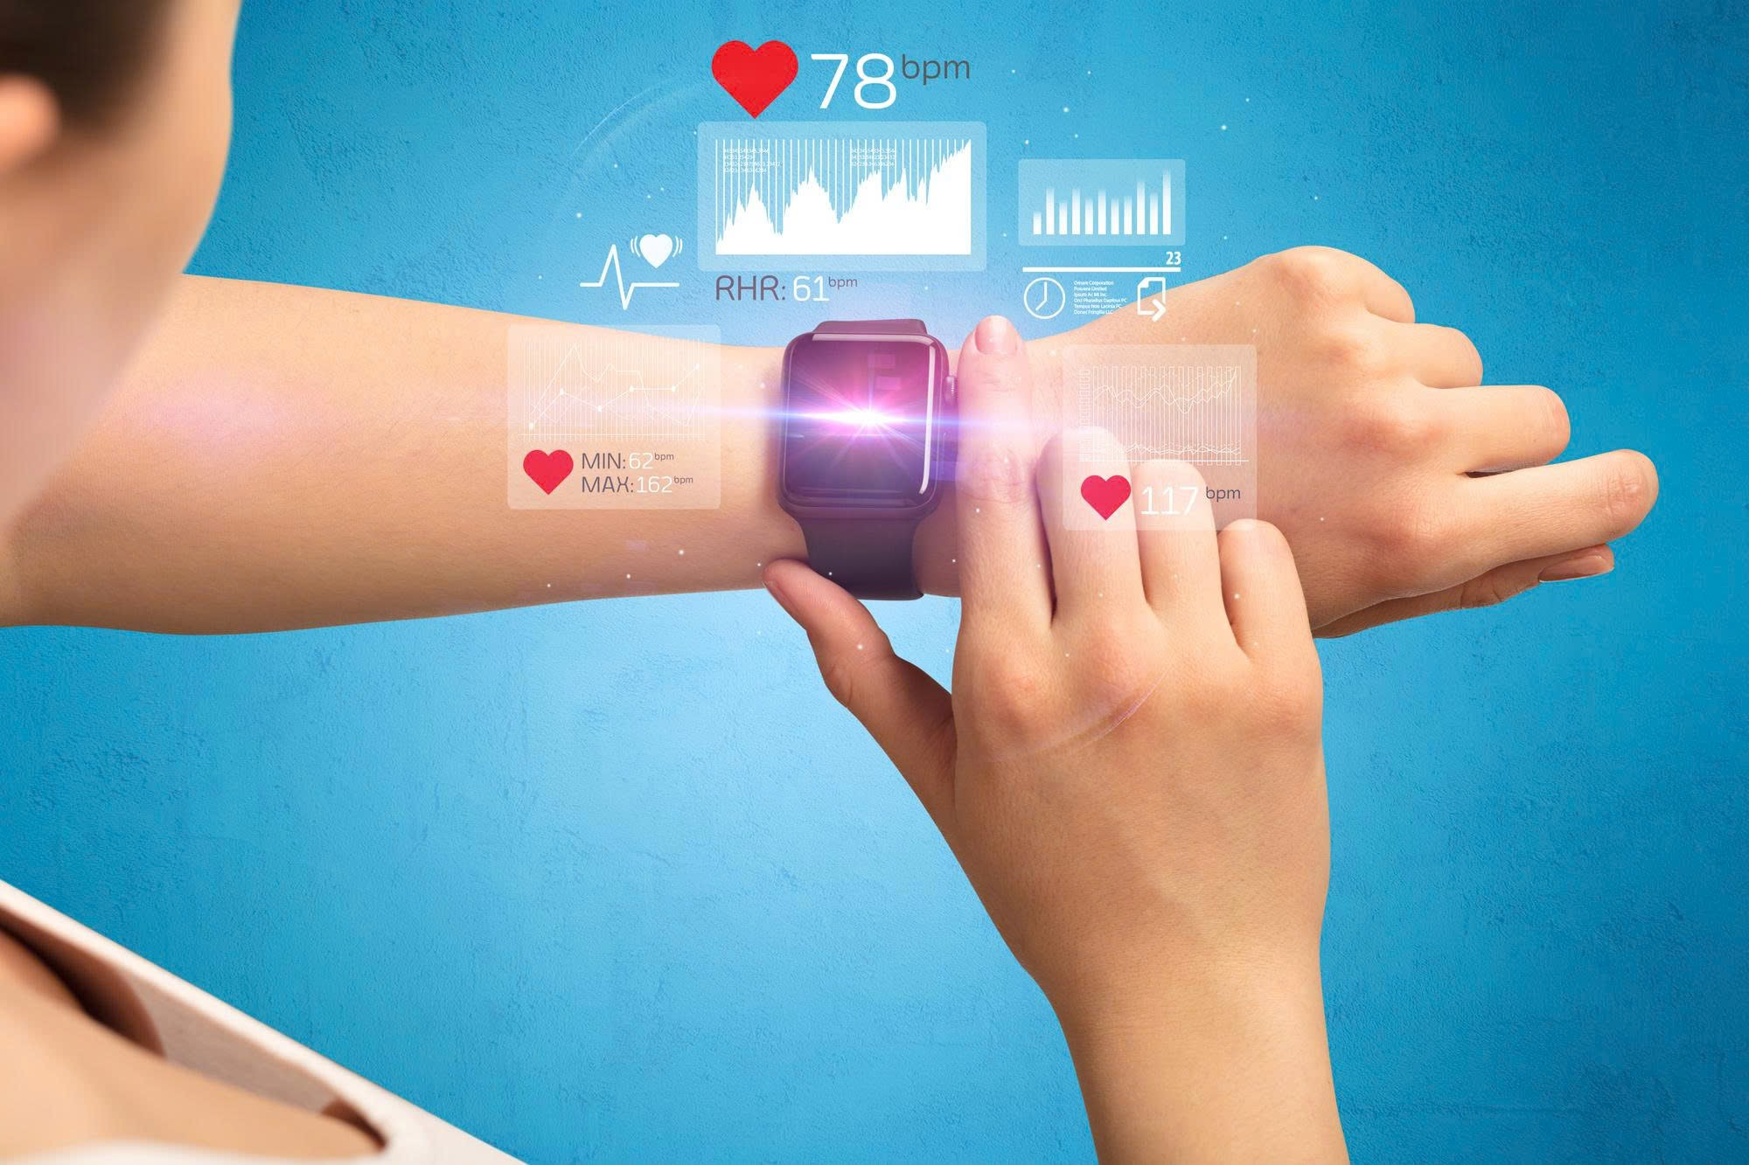
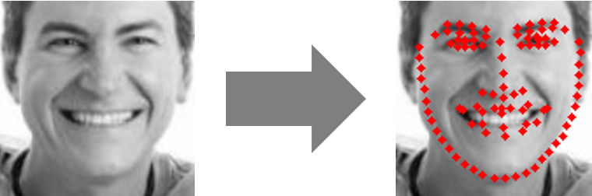

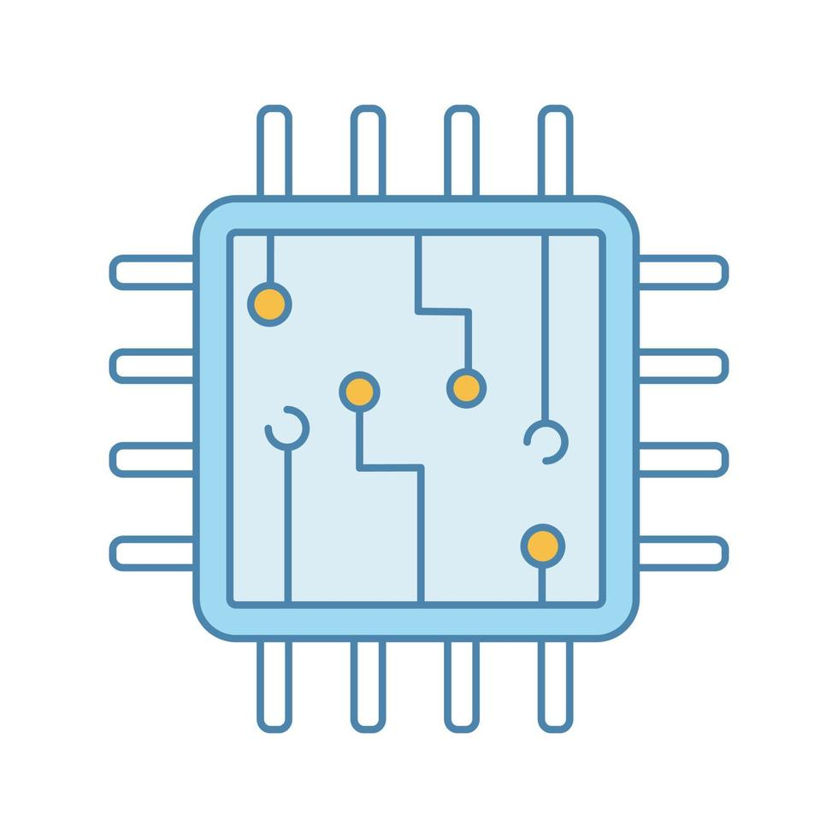

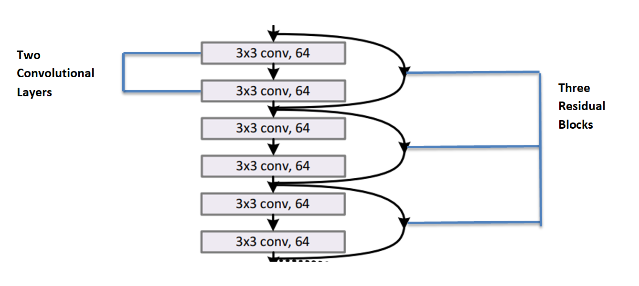
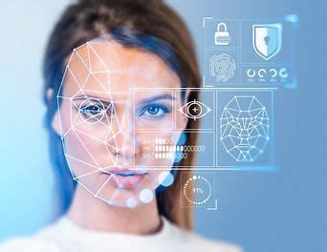

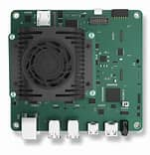
TECHNICAL SOLUTIONS
Technologies
Edge Solution
ASIC
Facial landmark detection
Highspeed
Extend
usage duration
ASIC Design
Accelerator
Edge Computing
Save energy
Edge device
Deep Learning
Image Processing
GRADUATION PROJECT 2025
COMPUTER ENGINEERING TECHNOLOGY

Slide 8
02
TECHNICAL SOLUTIONS
GRADUATION PROJECT 2025
COMPUTER ENGINEERING TECHNOLOGY

Slide 9


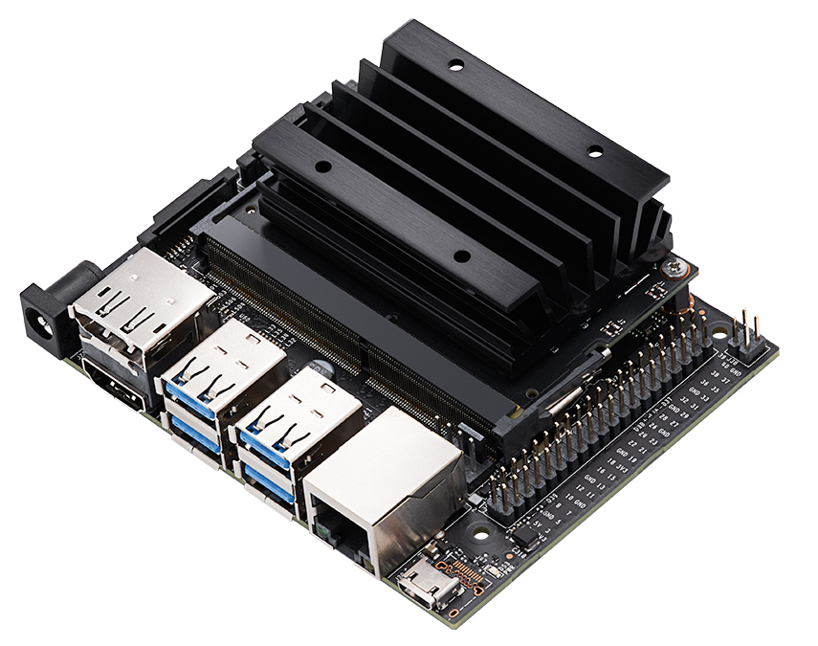


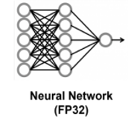
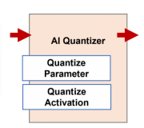
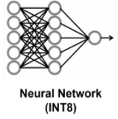
TECHNICAL SOLUTIONS
Software
SYSTEM SPECIFICATION DIAGRAM
Quantization
Dataset
PTQ
WFLW
Custom
MobileNetV2
Hardware
Vitis AI
QAT
Benchmark
GRADUATION PROJECT 2025
COMPUTER ENGINEERING TECHNOLOGY

Slide 10
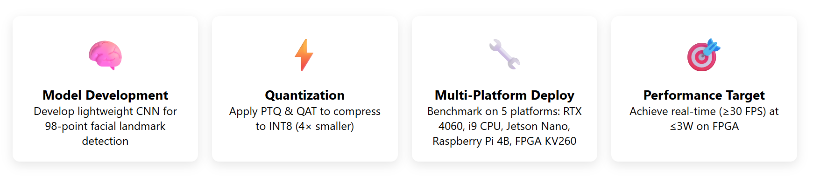
TECHNICAL SOLUTIONS
Four-Step Development Pipeline
GRADUATION PROJECT 2025
COMPUTER ENGINEERING TECHNOLOGY

Slide 11
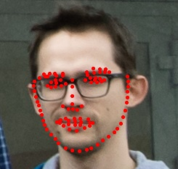
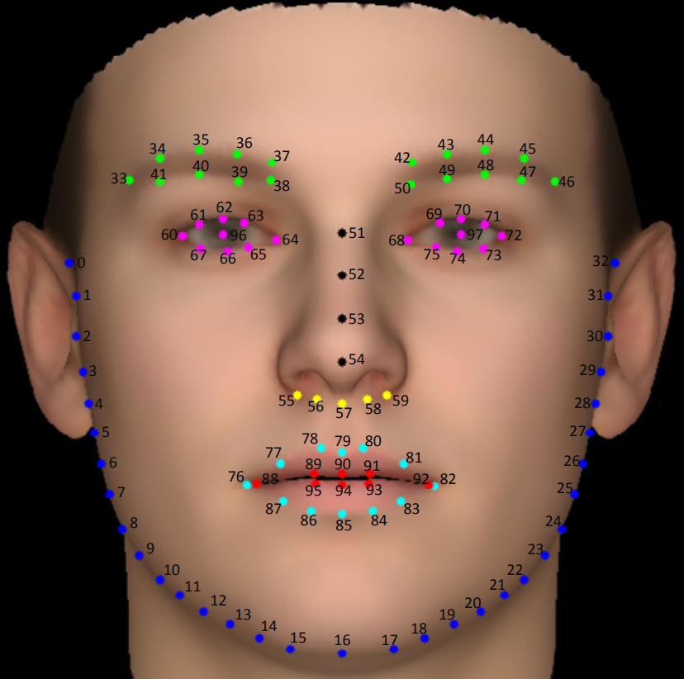
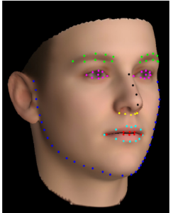
TECHNICAL SOLUTIONS
Sample image
Use to train MobileNetV2 model.
Image size: 112x112 pixels.
Total images: 10000 face images (7500 for training – 2500 for validation).
Landmark annotations: Each image contains 98 manually labeled facial landmarks.
Dataset
Some Research about Landmark:
MetaCloth: Learning Unseen Tasks of Dense Fashion Landmark Detection from a Few Samples - Yuying Ge,Ruimao Zhang, Ping Luo
Prediction of obstructive sleep apnea using facial landmarks - Asghar Tabatabaei Balaei, Kate Sutherland, Peter Cistulli and Philip de Chazal
> 100 landmarks increases annotation cost → No significant accuracy improvement; higher labeling effort and model complexity
< 80 landmarks miss subtle expressions → Insufficient for detecting eye closure, yawning, or head orientation changes
Using 96–100 landmarks stabilizes PERCLOS & MAR calculations → Less than 2% variance, ideal for drowsiness behavior analysis
68-point models show higher error under challenging conditions → Over 5% error in low-light or non-frontal poses, reducing reliability
→ WFLW is the most suitable dataset
WFLW
GRADUATION PROJECT 2025
COMPUTER ENGINEERING TECHNOLOGY

Slide 12
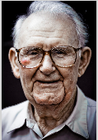
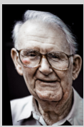
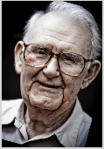
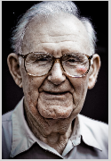
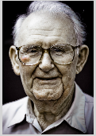
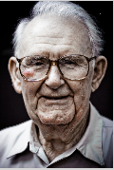
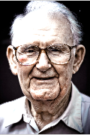
TECHNICAL SOLUTIONS
Geometric Augmentation
Rotation: ± 15°
Shearing: ± 10°
Horizontal / Vertical Flip
Photometric Augmentation
Brightness: ± 30%
Saturation: ± 10%
Hue Shift: ± 20%
Dataset
Augmentation
Shearing
Original
Horizontal
Flip
Hue Shift
Rotation
Saturation
Brightness
GRADUATION PROJECT 2025
COMPUTER ENGINEERING TECHNOLOGY

Slide 13
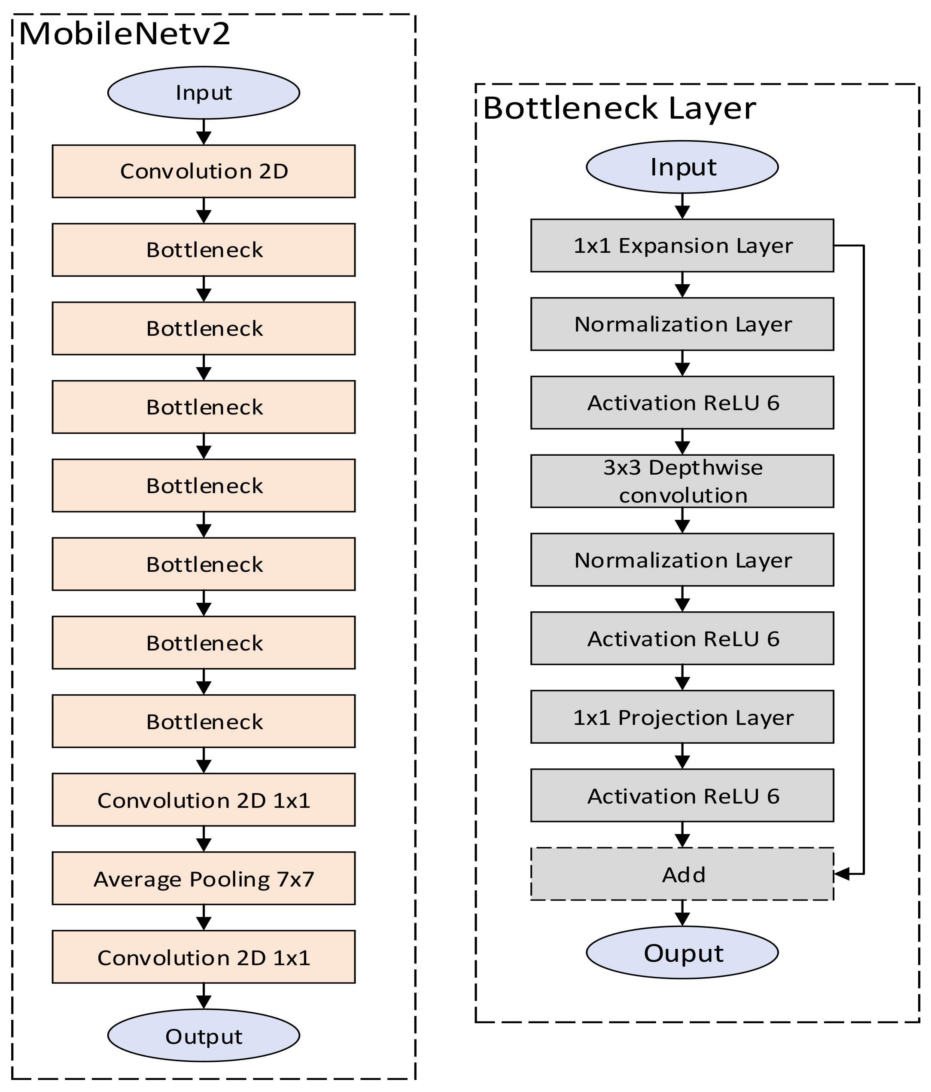
TECHNICAL SOLUTIONS
Input
Custom MobileNetV2
Bottleneck Layer
Conv_BN_ReLU 3x3
Input
Conv_BN_ReLU 3x3
Input
1x1 Expansion Layer
Inverted Residual
Conv_BN_ReLU 3x3
BatchNormalization
Inverted Residual
Activation ReLU
…………………....
Conv_BN_ReLU 3x3
3x3 Depthwise
convolution
Inverted Residual
Conv_BN_ReLU 3x3
BatchNormalization
Conv_BN_ReLU 3x3
Global Avg Pool
Activation ReLU
Conv 2D 1x1, BN, ReLU
Fully Connected + ReLU
1x1 Projection Layer
Global Avg Pool (x1,x2,x3)
Fully Connected (Pose Estimation)
Optinal Add
Fully Connected (Landmark prediction)
Auxiliary Net
Output
Output
GRADUATION PROJECT 2025
COMPUTER ENGINEERING TECHNOLOGY

Slide 14
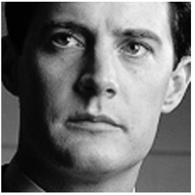
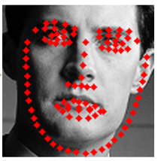
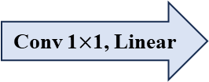
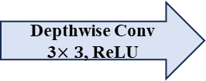
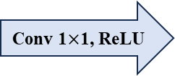
TECHNICAL SOLUTIONS
MobileNetV2 Building Blocks
Transformation
Conv 1$×$1, ReLU
Depthwise Conv
3$×3$, ReLU
Conv 1$×$1, Linear
Bottleneck
input
Add
Bottleneck
output
Shortcut
GRADUATION PROJECT 2025
COMPUTER ENGINEERING TECHNOLOGY

Slide 15
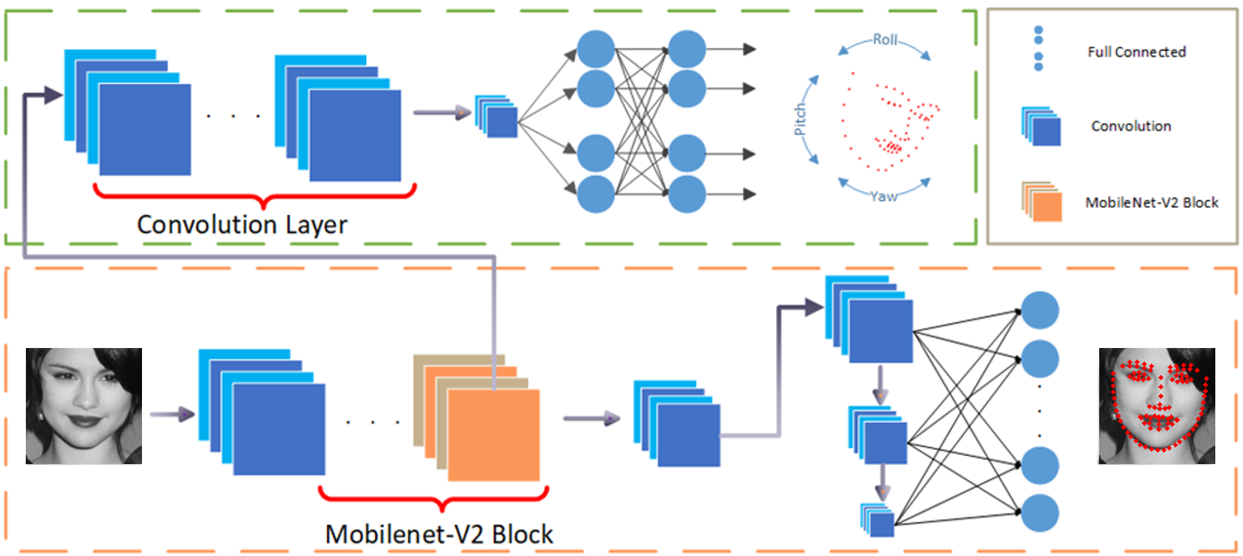
TECHNICAL SOLUTIONS
CNN Architecture and Backbone design
Auxiliary Model
MobileNetV2 backbone
GRADUATION PROJECT 2025
COMPUTER ENGINEERING TECHNOLOGY

Slide 16
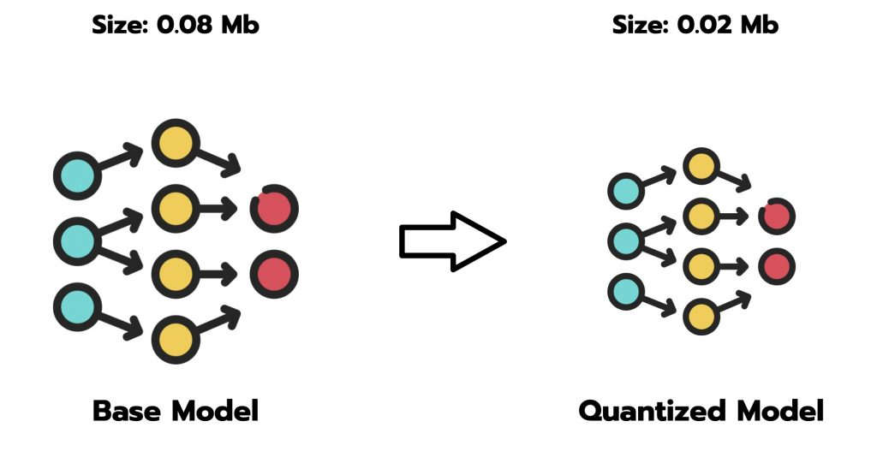
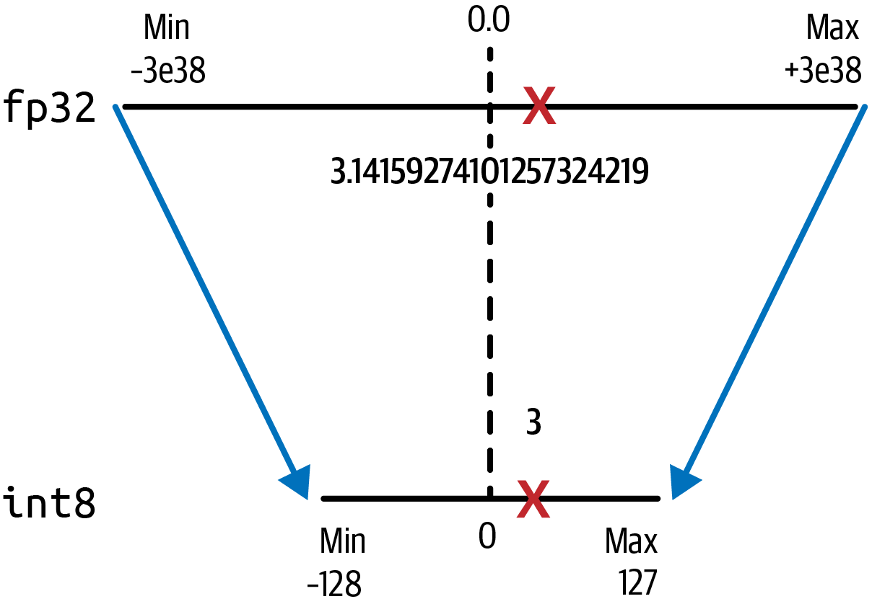



TECHNICAL SOLUTIONS
Limited on-chip memory
Fast inference
Real-time
Low power
Precision Loss
GRADUATION PROJECT 2025
COMPUTER ENGINEERING TECHNOLOGY

Slide 17



TECHNICAL SOLUTIONS
QAT
Method | Fake-quantization + Fine-tune
Compressed Model | 4x
Accuracy Drop | 0.2 - 0.5%
Time | Low (hours)
Advantage | Higher Accuracy
Scale = $\frac{ \text{max}\text{(}\text{INT}\text{8) − }\text{min}\text{(}\text{INT}\text{8) }}{\text{max}\text{(}\text{FP}\text{32) − }\text{min}\text{(}\text{FP}\text{32)}}$​
Zero Point = round ( ​$\frac{\text{min}\text{(}\text{FP}\text{32)}}{\text{Scale}}$ ​)
PTQ
Method | Static calibration
Compressed Model | 4x
Accuracy Drop | 1 - 2 %
Time | Fast (minutes)
Advantage | Quick Deployment
Quantized = round ( $\frac{\text{FP}\text{32 }\text{Value}\text{ − }\text{Zero} \text{Point}}{\text{Scale}}$​ )
Dequantized = Scale × Quantized Value + Zero Point
GRADUATION PROJECT 2025
COMPUTER ENGINEERING TECHNOLOGY

Slide 18
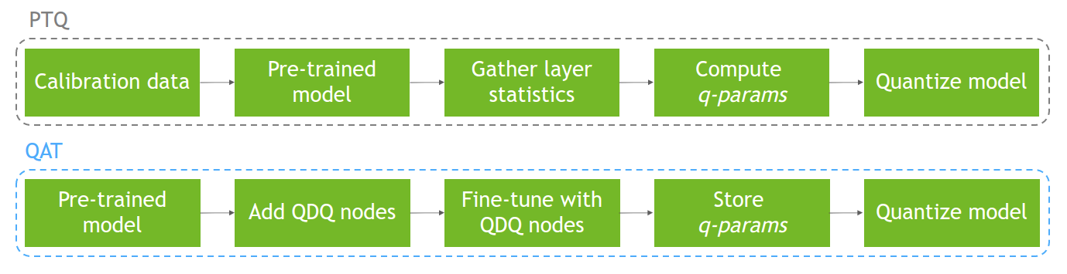
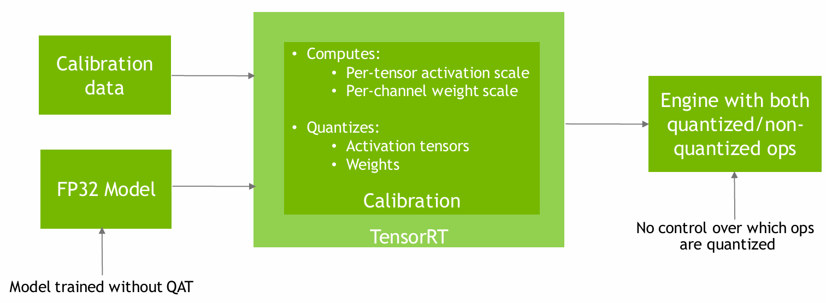
TECHNICAL SOLUTIONS
PTQ MODEL INFERENCE
GRADUATION PROJECT 2025
COMPUTER ENGINEERING TECHNOLOGY

Slide 19
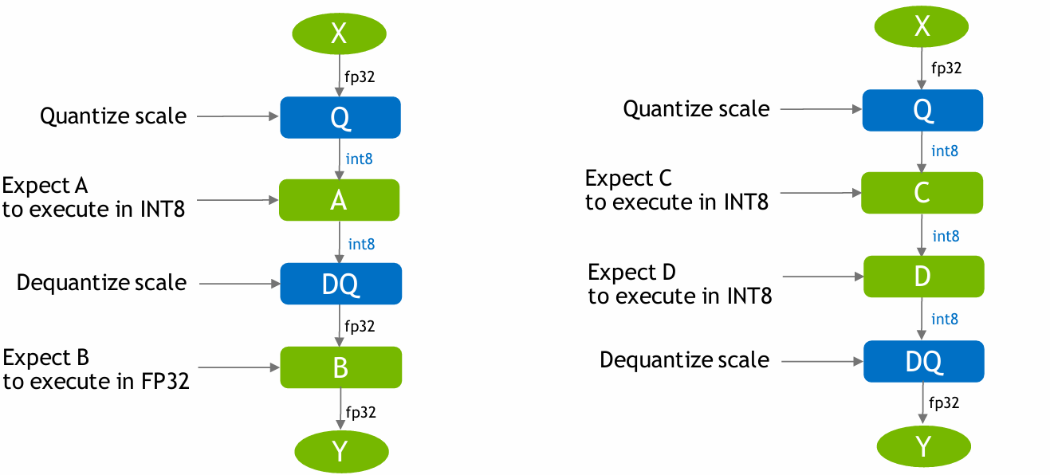
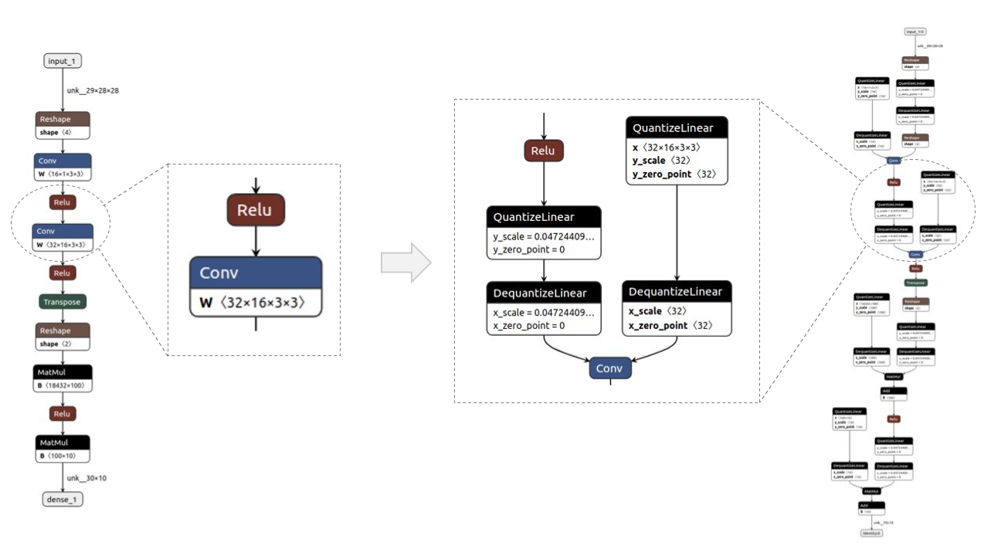
TECHNICAL SOLUTIONS
Pre-trained
model
Fine-tune
Add QDQ node
GRADUATION PROJECT 2025
COMPUTER ENGINEERING TECHNOLOGY

Slide 20
TECHNICAL SOLUTIONS
Voltage of platforms
Model Conversion Pipeline
Platform | Voltage | OS
Jetson Nano | 5V | Ubuntu 20.04
Raspery | 5V | Ubuntu 20.04
CPU | 12V | Window
RTX 4060 | 12V | Window
Kria KV260 | 12V | Petalinux
Platform | Model Conversion Pipeline
Jetson Nano | .pth → ONNX → TensorRT
Raspery | .pth → ONNX → TensorFlow → TFLite
CPU | .pth
RTX 4060 | .pth
Kria KV260 | .pth → xmodel
Comparison of Power Measurement Methods
Method | Accuracy | Sampling Rate | Cost | Complexity | Recommendation
INA219 | ±0.5% | 400 Hz | $5–10 | Medium | ⭐⭐⭐⭐⭐
jtop | ±5–10% | 10 Hz | Free | Easy | ⭐⭐⭐
tegrastats | ±5–10% | 10 Hz | Free | Easy | ⭐⭐⭐
External DMM | ±0.1% | 1 Hz | $100+ | High | ⭐⭐
GRADUATION PROJECT 2025
COMPUTER ENGINEERING TECHNOLOGY

Slide 21
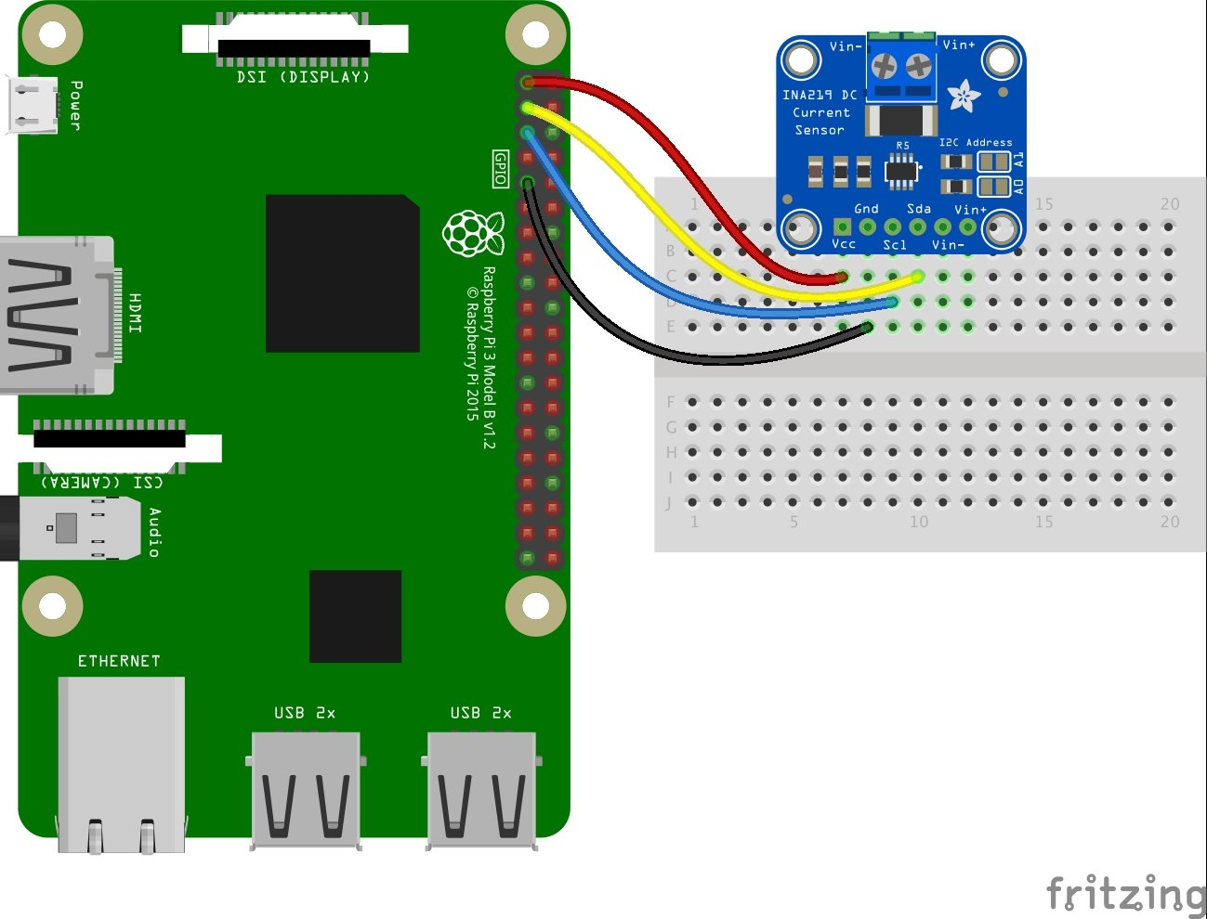
TECHNICAL SOLUTIONS
FPS Calculation
Power Measurement
1: model ← trained_model
2: device ← (cuda, cpu)
3: Load trained model to device.
4: Initialize the pipeline.
5: Get camera input as source.
6: Connect to the device and start the pipeline.
7: while True do
8: Convert the Grayscale frame to a PyTorch tensor.
9: Perform inference using the model.
10: Calculate FPS.
11: if model == MTCNN then
12: Identify face and draw a box.
13: else
14: if model == MobileNetV2 then
15: Facial landmark detection
16: end if
17: end if
18: end while
INA219
GRADUATION PROJECT 2025
COMPUTER ENGINEERING TECHNOLOGY

Slide 22
03
RESULTS
GRADUATION PROJECT 2025
COMPUTER ENGINEERING TECHNOLOGY

Slide 23

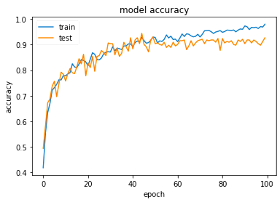
RESULTS
Training configuration
Result with baseline FP32
Learning Rate | 1e-4 (0.001)
Optimizer | Adam (weight_decay = 1e-5)
Batch size | 64
Loss function | Weighted Pose-Aware MSE
NUM_EPOCHS | 100
DEVICE | Cuda
Framework | Pytorch
GRADUATION PROJECT 2025
COMPUTER ENGINEERING TECHNOLOGY

Slide 24
RESULTS
Quantization Method | Accuracy (%) | Model Size (MB) | Quantization Time | Compression Ratio
Original (FP32) | 92.42 | 6.59 | - | 1x
QAT (INT8) | 91.74 | 1.65 | ~3 hours (fine-tune) | 4x
PTQ (INT8) | 90.94 | 1.65 | ~10 minutes (calibration) | 4x
GRADUATION PROJECT 2025
COMPUTER ENGINEERING TECHNOLOGY

Slide 25
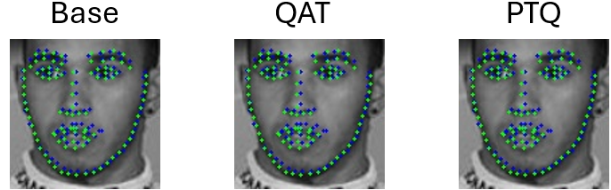
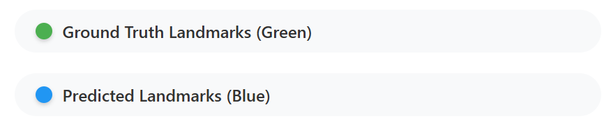
RESULTS
GRADUATION PROJECT 2025
COMPUTER ENGINEERING TECHNOLOGY

Slide 26
ARCHIEVED RESULTS
Platform |  | FPS | Power (W) | FPS/W | Accuracy (%) | Use-Case
SOFTWARE | RTX 4060 (1.83 – 2.46 GHz) | 430 | 110 | 3.91 | 92.42 | High-performance AI training and complex processing
 | CPU i9 (3.20 – 5.50 GHz) | 108 | 80 | 1.35 | 92.42 | General development and flexible AI applications
 | Jetson Nano (0.475 GHz) | 9 | 10 | 0.90 | 92.42 | Low-cost edge AI prototyping and robotics
 | Raspberry (0.600 GHz) | 6 | 7 | 0.79 | 92.42 | Educational projects and battery-powered sensors
HARDWARE | Kria KV260 (0.300 – 0.400 GHz) | 30 | 3 | 10 | 91.74 | Best energy efficiency for real-time facial landmark detection at the edge
GRADUATION PROJECT 2025
COMPUTER ENGINEERING TECHNOLOGY

Slide 27
RESULTS
Author | Model (Size) | Hardware | Quantization | Accuracy (%) | FPS | Power (W) | FPS/W | Application
Zhang et al. (2022) | TinyYOLOv3-based (8.3 MB) | ZCU102 | PTQ (INT8) | 92.5 | 18 | 2.4 | 7.5 | Face detection
Alhussain & Lin (2023) | Two‑Stream SimpleNet (~1.3M params) | ZCU104 | QAT (INT8) | 81% | 24 | - | - | Face Detection
Nitta (2020) | MTCNN (68 MB) | Ultra96‑V2 | PTQ (INT8) | - | 22 | - | - | Face mask detection
Proposed (This Work) | Custom MobileNetV2 – Quantized (1.65 MB) | FPGA (Kria KV260) | QAT (INT8) | 91.74 | 30 | 3.15 | 9.52 | Facial landmark detection
GRADUATION PROJECT 2025
COMPUTER ENGINEERING TECHNOLOGY

Slide 28
04
CONCLUSION
GRADUATION PROJECT 2025
COMPUTER ENGINEERING TECHNOLOGY

Slide 29
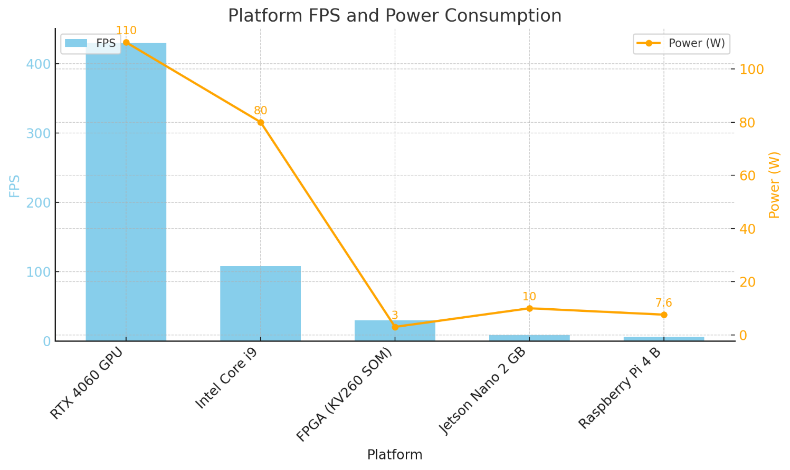

CONCLUSION
🏆FPGA KV260
Energy Efficiency: 10 FPS/W, ~10× better than GPU
Latency: 33ms, suitable for real-time applications
Trade-off: Slight accuracy drop (0.68%) due to INT8 quantization
FPGA KV260 achieves 10 FPS/W, making it ideal for battery-powered automotive systems
GRADUATION PROJECT 2025
COMPUTER ENGINEERING TECHNOLOGY

Slide 30





CONCLUSION
Results & Societal Impact
GRADUATION PROJECT 2025
COMPUTER ENGINEERING TECHNOLOGY

Slide 31
CONCLUSION
ARCHIEVEMENT
Develop a light weight CNN for 98-point facial landmark detection
Achieved real-time inference with 30 FPS and 3W power
Established benchmark performance for edge AI deployment across 5 platforms: RTX 4060, Intel i9, Jetson Nano
Raspberry Pi 4B, and Xilinx Kria KV260 FPGA
LIMITATION
Model accuracy does not exceed the 95% threshold
FPGA deployment is functional but lacks full optimization
Lack of cross-dataset evaluation to assess generalization
Limited robustness under extreme head poses or heavy occlusion
GRADUATION PROJECT 2025
COMPUTER ENGINEERING TECHNOLOGY

Slide 32
05
FUTURE DIRECTION
GRADUATION PROJECT 2025
COMPUTER ENGINEERING TECHNOLOGY

Slide 33

FUTURE DIRECTION
Design a custom model architecture and loss function tailored for drowsiness detection and optimized for edge deployment.
Develop a dedicated hardware accelerator for efficient CNN execution on FPGA platforms.
Explore ultra-low precision quantization techniques (INT4 or INT2) to further reduce latency and power consumption.
Extend the system into a reusable IP core for real-time drowsiness detection in embedded applications
GRADUATION PROJECT 2025
COMPUTER ENGINEERING TECHNOLOGY

Slide 34
References
Zhang et al. (2022): H. Zhang, L. Chen, and P. Wang, “FPGA implementation of TinyYOLOv3-based face detection with INT8 quantization,” IEEE Transactions on Circuits and Systems for Video Technology, vol. 32, no. 4, pp. 987–996, Apr. 2022.
Alhussain & Lin (2023): A. Alhussain and M. Lin, “FPGA-QHAR: Throughput-optimized quantized human action recognition on the edge,” arXiv preprint arXiv:2311.03390, Nov. 2023. [Online]. Available: https://arxiv.org/abs/2311.03390.
Nitta (2020)[50] Y. Nitta, “Real-time tiny-YOLOv3 face mask detection on Ultra96-V2 using Vitis-AI,” Hackster.io Project, Jun. 2020. [Online]. Available: https://www.hackster.io/yasuhironitta/real-time-tiny-yolov3-face-mask-detection-on-ultra96v2-63a70c
GRADUATION PROJECT 2025
COMPUTER ENGINEERING TECHNOLOGY

Slide 35

Thanks for your evaluation!

